Slide 1


Scrap Analysis and Mitigation Strategies
This presentation provides a comprehensive analysis of scrapping activities, highlighting key metrics, classifications, and financial impact to facilitate informed decision-making and implement mitigation strategies.
by kirollos simon

Slide 2
Scrap Analysis: Overview
Scrap Analysis: Key Metrics
Scrap Classification and Plant Distribution
Risk & Financial Insights
80
90
Additional Insights
70
0
60
10
SWOT Analysis
50
20
40
30
ML EDA Overview
Correlation & Risk View
Streamlit ML Estimator

Slide 3
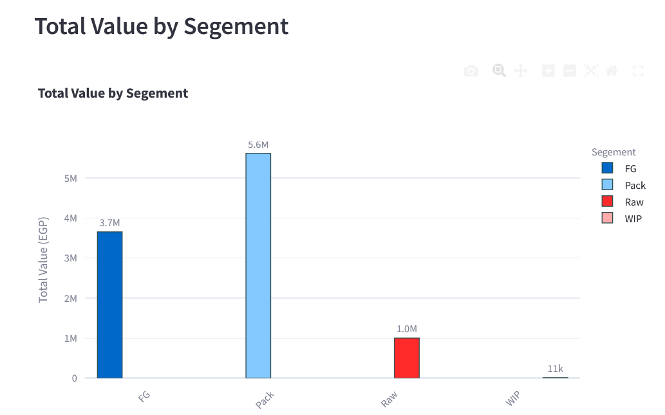
Scrap Analysis: Key Metrics
Total Scrapped Quantity
Total Scrapping Value
Count of Unique Products
27,636 PC
10,283,374 EGP
197
Understand the diversity of products affected by scrapping, identifying potential areas for process optimization.
Analyze the total volume of scrapped materials, providing insights into the overall magnitude of waste
Assess the financial impact of scrapping, highlighting the monetary loss associated with unusable materials.

Slide 4
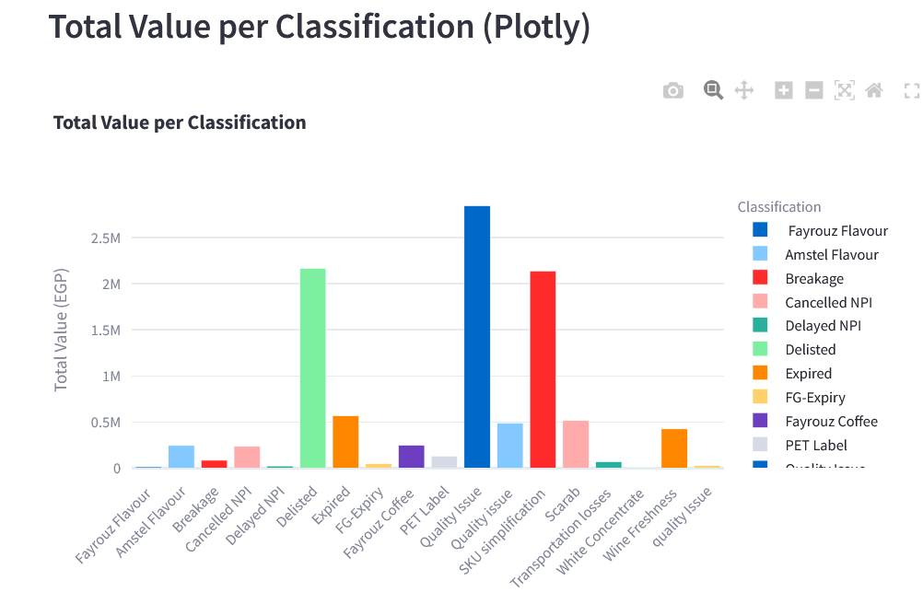
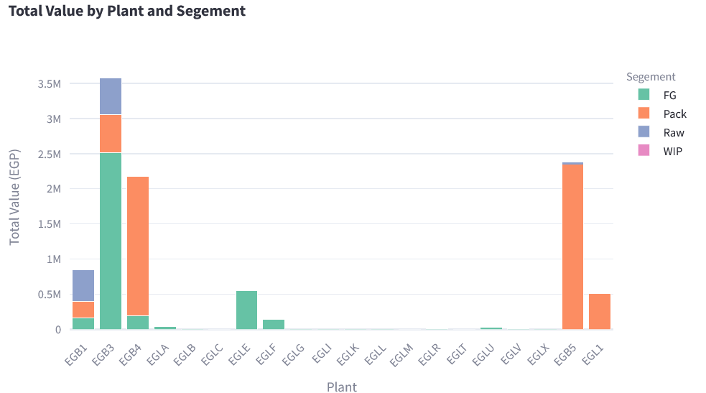
Scrap Classification and Plant Distribution
Total Value by Classification
Plant-wise Contribution to Scrapping
Categorize scrapping reasons to identify high-cost classifications, focusing on areas for targeted improvement.
Analyze plant-level scrapping contributions, pinpointing plants with high scrapping rates, and potentially revealing underlying issues.

Slide 5
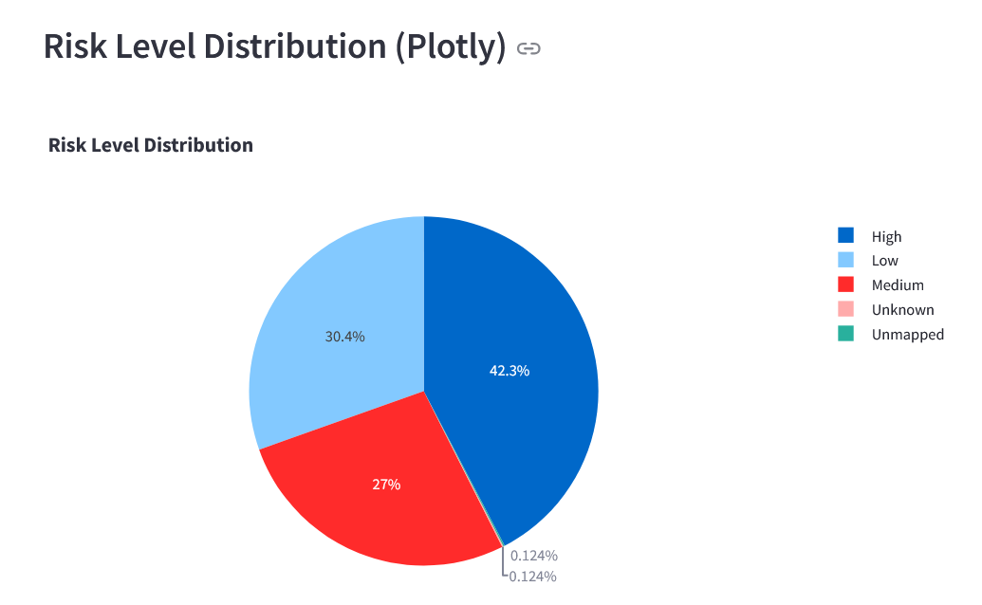
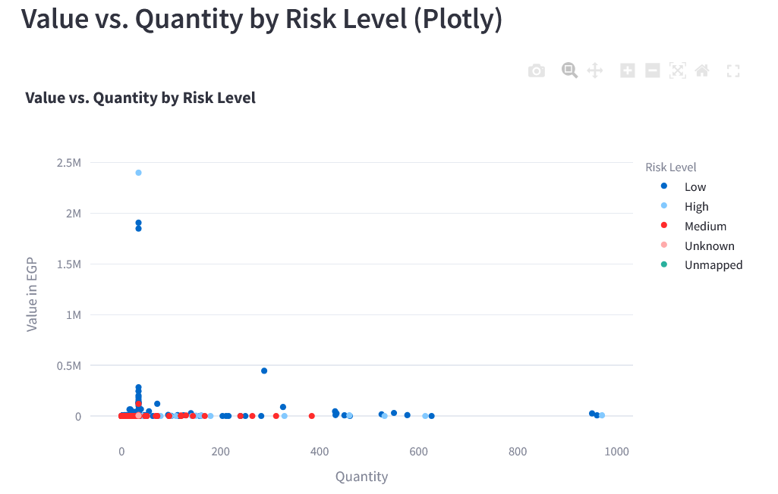
Risk Assessment and Financial Impact
Financial Impact &
Risk Level Distribution:
Total losses in 10.3 Milon EGP due to scrapping
This insight helps identify the most prevalent risk levels contributing to scrapping.
30% Low
27% Medium
42 % High
Correlation Between Quantity and Value:
Analysis shows a strong correlation between scrapped quantity and value for high-risk items.
The majority of quantities and risks fall within the range of 0 to 0.5 million.

Slide 6
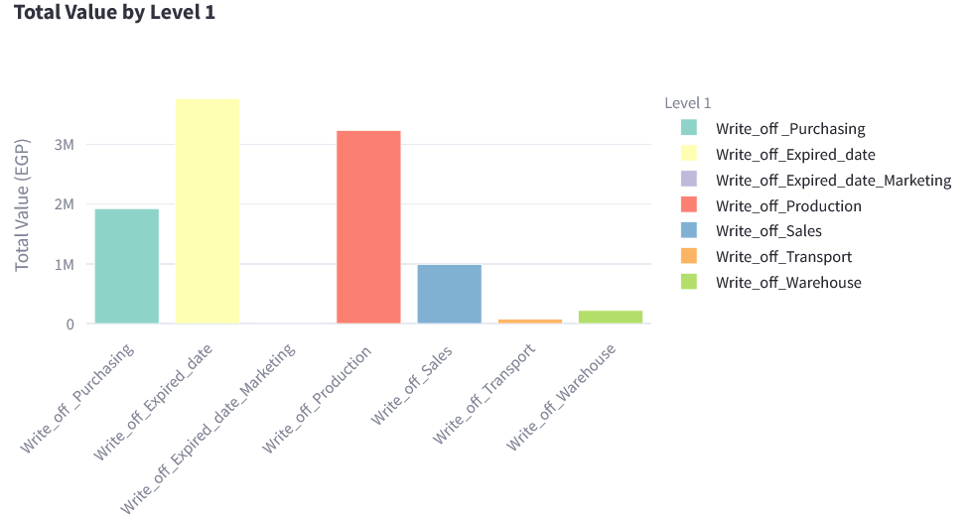
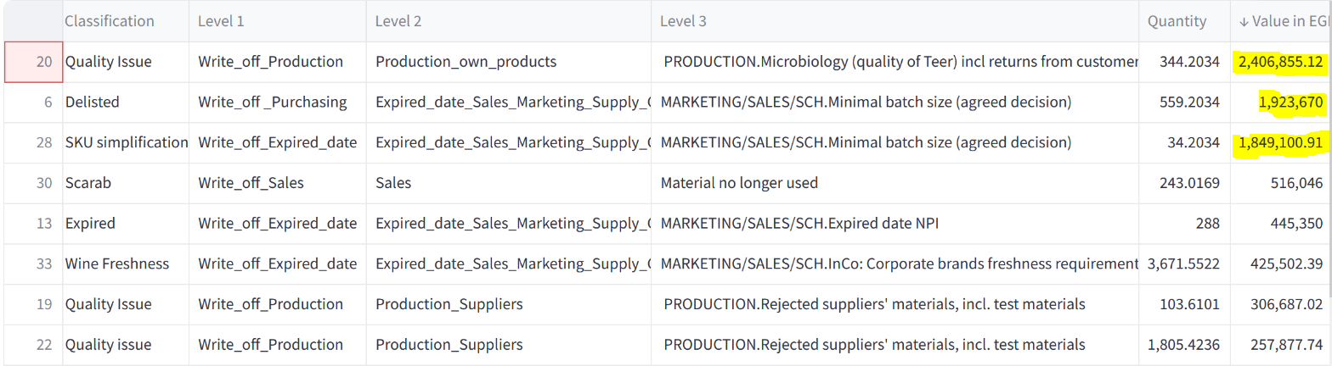
Additional Insights
Root Causes:
Write_off_purchasing 30.7%
Write_off_Expired_data_Marketing 32%
Write_off_Expired_date 19%
Opportunities:
Implementing automation to minimize scrapping incidents.
Using predictive models to identify and address root causes effectively.

Slide 7
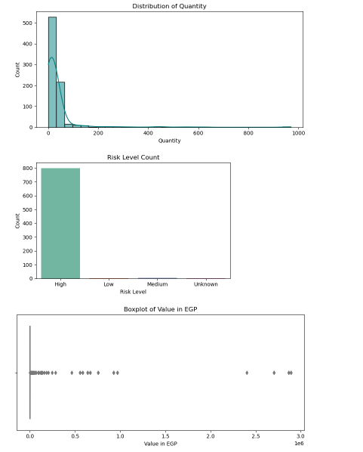
ML EDA Overview
Over 90% of scrap cases are
classified as High Risk:
While most quantities are under 100 units, a few items exceed 1,000, causing losses above 100,000 EGP
:

Slide 8
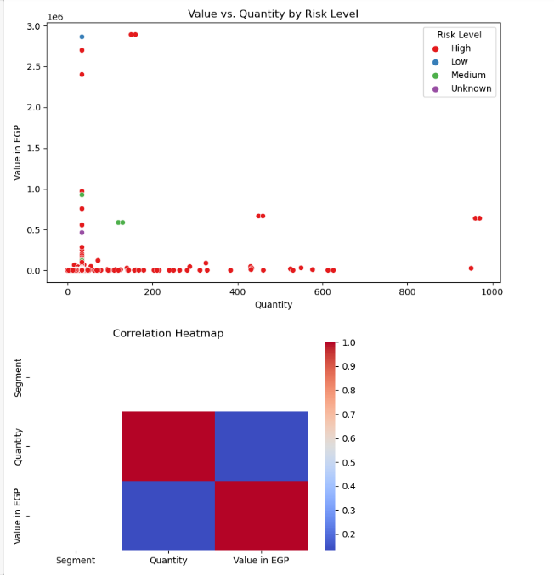
Correlation & Risk View
A positive correlation (r ≈ 0.75)
exists between quantity and scrap
value in high-risk products
Most risky losses are in the range of 10–200 units, with scrap values exceeding 50,000 EGP.
:

Slide 9
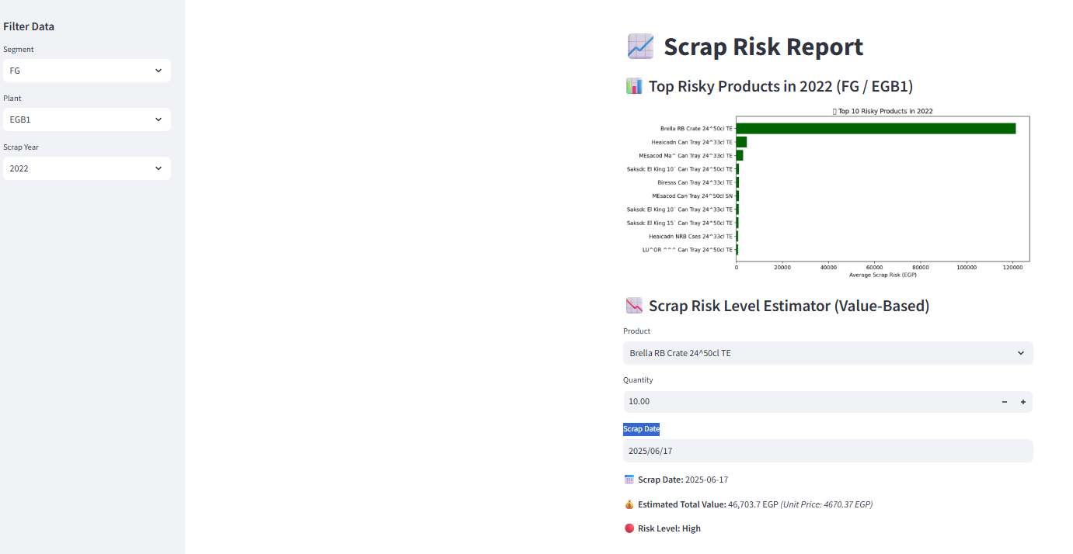
Streamlit ML Estimator
It estimates the total value and shows the risk as Low, Medium, or High to support better decisions
This tool predicts scrap risk instantly
based on inputs like Segment
, Plant, Product, Date, and Quantity
:

Slide 10
Thank You
Empowering Data-Driven Decisions for a Profitable Future
by kirollos simon

Slide 11
SWOT Analysis
S
Strengths
Weaknesses
W
Recurring Issues in Specific Plants: (EGB3)
Lack of Proactive Measures:
Misalignment between Marketing, Demand Planning, and Operations teams
Easy scrap risk prediction
Product-level insights
Fast decisions via ML tool
SWOT
Analysis
O
T
Opportunities
Threats
Plant-Specific Action Plans:EGB3
Collaboration with Marketing and Demand Teams:
Quality Control Enhancements:
Market Demand Fluctuations:
Continued inefficiencies in plants like EGB3 could result in increased financial setbacks.

Slide 12
Thank You
Empowering Data-Driven Decisions for a Profitable Future

Slide 13
Thank You
Empowering Data-Driven Decisions for a Profitable Future

Slide 14
Thank You
Empowering Data-Driven Decisions for a Profitable Future

Slide 15
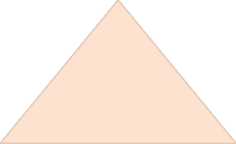
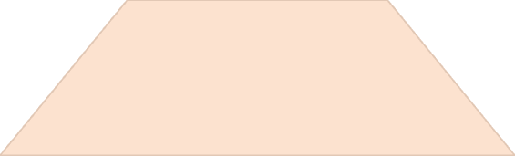
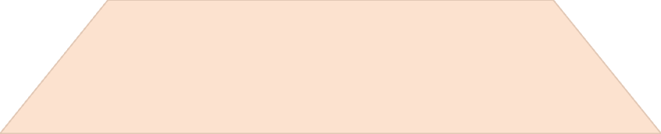
Hierarchical Analysis of Scrapping
Level 1
1
Primary reasons for scrapping.
Level 2
2
Sub-categories of Level 1.
Level 3
3
Detailed breakdown of Level 2.

Slide 16
SWOT Analysis
S
Strengths
Weaknesses
W
Diverse Car Portfolio
Strong Market Presence
Premium Pricing Opportunities
Price Sensitivity
Limited Fuel-Efficient Options
SWOT
Analysis
O
T
Opportunities
Threats
Growing Electric Vehicle Market
Expanding Global Presence
Intense Competition
Economic Downturn

Slide 18
ML EDA Overview
Distribution plots show that scrap quantity is highly skewed, with most values low. Over 90% of items are labeled as High Risk, and scrap values have a wide spread with several costly outliers.

Slide 19
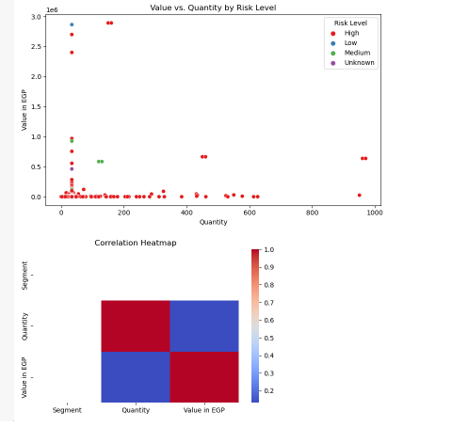
ML Correlation & Risk View
There’s a strong correlation between quantity and value for high-risk items. Most high-value risks are clustered under low quantity. The heatmap confirms this positive correlation.

Slide 20
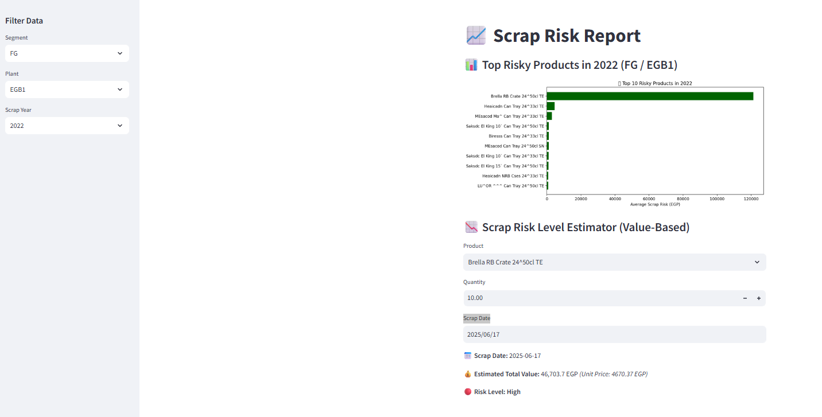
Streamlit ML Prediction View
Users can filter by segment, plant, and product to estimate risk. The model predicts the total value and classifies the risk level dynamically, enhancing proactive scrap mitigation.

